Slide 1

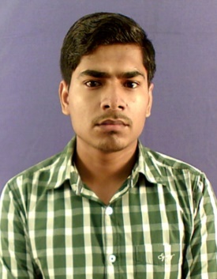
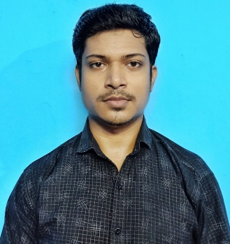
B.TECH MAJOR PROJECT PRESENTATION 2020-21
Computer To Computer Learning System
Project ID:21103
By
Student 1: Abhishek Kumar
Roll No: CSE201710094
BPUT Regn. No:1701202318
Student 2: Rahul Kumar Yadav
Roll No: IT201710355
BPUT Regn. No:1701202081
Under the guidance of
Mr. Santosh Kumar Kar
Abhishek Kumar (CSE201710094) & Rahul Kumar Yadav (IT201710355)
Notes:
B-TECH PROJECT MID-SEM PRESENTATION 2011
BY KHUSHBU KHAN & ISAN SAHOO

Slide 2
B.TECH MAJOR PROJECT PRESENTATION 2020-21
Slide Title
INTRODUCTION
MOTIVATION/OBJECTIVE
DIFFERENT MODULE
USE-CASE DIAGRAM
DELIVERABLE OF THE PROJECT
WORK COMPLETED
SCOPE OF THE PROJECT
Abhishek Kumar (CSE201710094) & Rahul Kumar Yadav (IT201710355)

Slide 3
B.TECH MAJOR PROJECT PRESENTATION 2020-21
Introduction
Computer to computer learning system is a modern way of education, it offers more variety of instructional methods such as text, videos, audio , and digital copies, which can be tailored according to needs of the learner. In this project there are three modules such as Admin, College Faculty and Student in which admin handle the whole scenarios like admin can give access to college faculty and student and delete them if he feels that they are unauthorized members of this system.
Abhishek Kumar (CSE201710094) & Rahul Kumar Yadav (IT201710355)

Slide 4
B.TECH MAJOR PROJECT PRESENTATION 2020-21
Motivation/Objective
The objective of this project is to develop the environment where various college institutes will provide their respective materials in form of text document ,pdf , etc . Students will able to refer those materials at any point of time when they need, so that they can grasp their study materials in a better way.
Abhishek Kumar (CSE201710094) & Rahul Kumar Yadav (IT201710355)

Slide 5
B.TECH MAJOR PROJECT PRESENTATION 2020-21
Different Module
In this project there are three modules-:
1.Admin
2.College Faculty
3.Student
Abhishek Kumar (CSE201710094) & Rahul Kumar Yadav (IT201710355)

Slide 6
B.TECH MAJOR PROJECT PRESENTATION 2020-21
Use-Case Diagram
Admin College Faculty
Register
login
Login
Approve institute
Upload Articles
Delete institute
View students & colleges
Faculty mgmt.
Update profile
View & Send response
Send response
Logout
Abhishek Kumar (CSE201710094) & Rahul Kumar Yadav (IT201710355)

Slide 7
B.TECH MAJOR PROJECT PRESENTATION 2020-21
Use-Case Diagram
Register
Login
Student
Download Articles
Update Profile
Send Request
View Response
Abhishek Kumar (CSE201710094) & Rahul Kumar Yadav (IT201710355)

Slide 8
B.TECH MAJOR PROJECT PRESENTATION 2020-21
Deliverable of the project
This system maintains all the records in online system database which makes it very easy to access and retrieve data from the database .
This system provides centralized database management.
This project facilitates student to easily navigate through the application for more information in a most secure manner.
Abhishek Kumar (CSE201710094) & Rahul Kumar Yadav (IT201710355)

Slide 9
B.TECH MAJOR PROJECT PRESENTATION 2020-21
Work Completed
In this project till now we have completed the frontend part and backend part of all the three modules like we have Admin, College Faculty and Student modules and in each module, we have different functions such as admin services are approving the institute, delete institute and other functions similarly college services are upload articles, update profile, send response for appropriate requests, view requests and same as for student update profile, send request to the college, send feedback.
Abhishek Kumar (CSE201710094) & Rahul Kumar Yadav (IT201710355)

Slide 10
B.TECH MAJOR PROJECT PRESENTATION 2020-21
Scope of the project
In this system admin can view the responses given by student and services are approve institute , delete institute, view students , send response.
College faculty services are upload articles , faculty management, update profile, send responses and view request.
Student functionalities are update profile, download files, send request to college and admin, view responses.
Abhishek Kumar (CSE201710094) & Rahul Kumar Yadav (IT201710355)

Slide 11
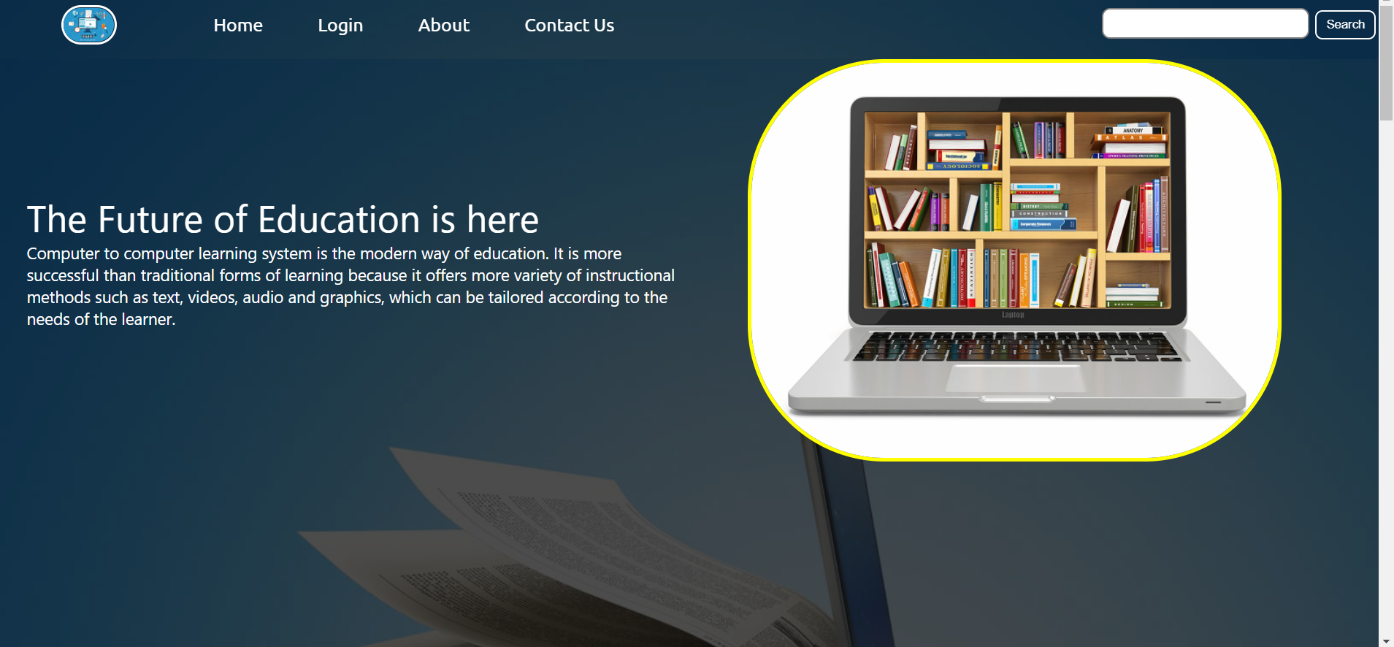
B.TECH MAJOR PROJECT PRESENTATION 2020-21
Homepage
Abhishek Kumar (CSE201710094) & Rahul Kumar Yadav (IT201710355)

Slide 12
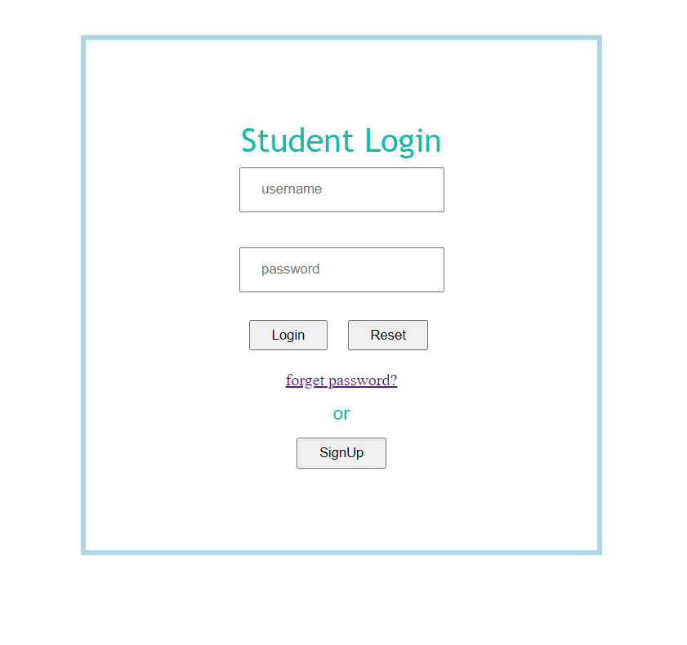
B.TECH MAJOR PROJECT PRESENTATION 2020-21
Student Login
Abhishek Kumar (CSE201710094) & Rahul Kumar Yadav (IT201710355)

Slide 13
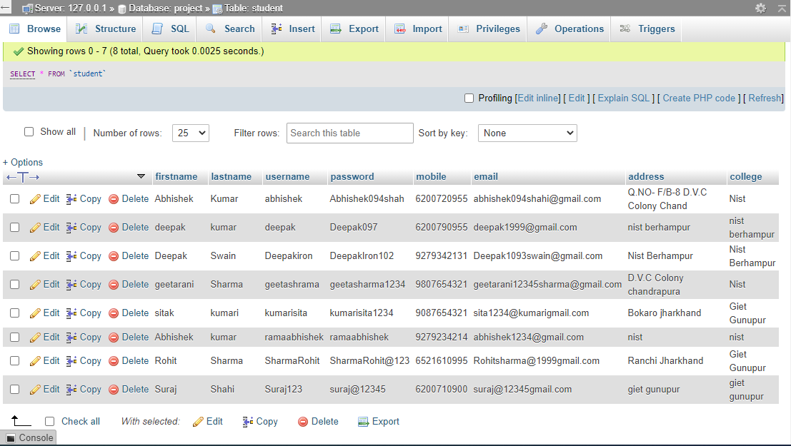
B.TECH MAJOR PROJECT PRESENTATION 2020-21
Student Table
Abhishek Kumar (CSE201710094) & Rahul Kumar Yadav (IT201710355)

Slide 14
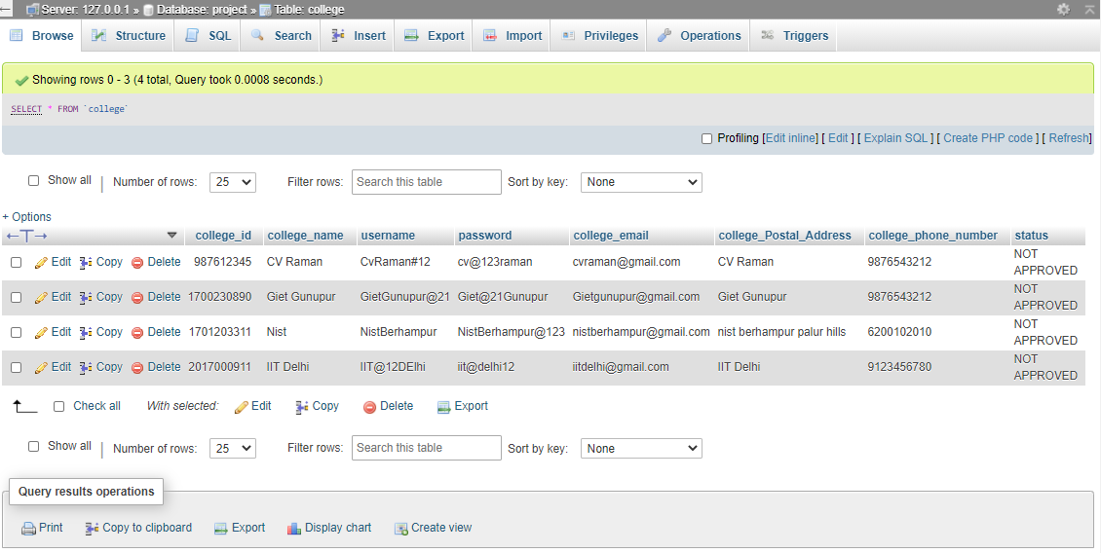
B.TECH MAJOR PROJECT PRESENTATION 2020-21
College Table
Abhishek Kumar (CSE201710094) & Rahul Kumar Yadav (IT201710355)

Slide 15
B.TECH MAJOR PROJECT PRESENTATION 2020-21
References
Core Java 2 Volume II - Advanced Pearson Education – Sun Microsystems(Cay S. Hortsman , Gary Cornell)
Effective Java- Programming Language Guide Pearson Education – Sun Microsystems (Joshua Bloch)
Java Database Best Practices O’Reilly – SPD(George Reese)
The Book of JavaScript 2nd Edition SPD ( thau)
Abhishek Kumar (CSE201710094) & Rahul Kumar Yadav (IT201710355)

Slide 16
B.TECH MAJOR PROJECT PRESENTATION 2020-21
Thank You
Abhishek Kumar (CSE201710094) & Rahul Kumar Yadav (IT201710355)

